Slide 1
Chapter 4
JDBC Connectivity

Slide 2
Database
Databases store the data in the form of tables with each table containing several records of data in row and column.
Databases are broadly categorized into two types as listed below:
  Single table databases and
  Multi table or relational databases.
A single table databases doesn’t mean that they have just one table. It will have several tables of data and all the tables are independent of each other.
The main drawback with these databases is the lack of flexibility while retrieving the data.
On the other hand in multi table databases, two or more tables are related with other. This feature offers more flexibility and power to retrieve the data.
These databases are therefore called as relational databases. Most of the modern enterprises use relational databases.

Slide 3
Structured Query Language (SQL)
SQL (Structured Query Language) is a computer language for storing, manipulating and retrieving data stored in a relational database.
SQL is used for creating the tables, populating the tables with data, manipulating the data in the tables, deleting the data in the tables and the tables itself.

Slide 4
Creating a table
Let’s create a table named Customers to store customer data like firstname, lastname, city, and country as shown below:
CustomerID | FirstName | LastName | City | Country

Slide 5
Syntax
CREATE TABLE table_name (
column1 datatype,
column2 datatype,
column3 datatype,
....
);

Slide 6
To create the Customer table, the SQL query will be as shown below:
CREATE TABLE Customer (
CustomerID int,
FirstName varchar(255),
LastName varchar(255),
Country varchar(255),
City varchar(255)
);

Slide 7
While creating table, it’s very important to mention the type of data that will be stored in various columns.
VARCHAR is a standard datatype for storing text data.
DATE is used for storing date
INT is used for storing numbers.
The numbers in parenthesis represent the maximum length of data that can be stored.

Slide 8
Inserting the data into the table
To insert the data into the tables, we use the INSERT query.
A single insert query inserts one record or row of data. Following is the sql syntax.
Syntax 1
  INSERT INTO table_name (column1, column3, column2, ...) VALUES (value1, value2, value3, ...);
Syntax 2
  INSERT INTO table_name VALUES (value1, value2, value3, ...);
In syntax 1, you don’t need to insert value to all column. Order of column doesn't matter in this syntax
In syntax 2, you don’t need to specify the column names in the SQL query. However, make sure the order of the values is in the same order as the columns in the table. Also, You need to populate value for all column.

Slide 9
Example:
INSERT INTO Customers (CustomerID, FirstName, LastName, Country, City) VALUES (123456, ‘Smith’, ‘John’, ‘USA’, ‘Vegas’);
INSERT INTO Customers VALUES (123456, ‘Smith’, ‘John’, ‘Vegas’, ‘USA’);

Slide 10
Updating Record in table
To update the data in an existing record, we use the UPDATE query statement.
The syntax for this query is shown below:
  UPDATE table_name SET column1 = value1, column2 = value2, ...WHERE condition;
Let’s say we want to change the last name to ‘Roberts’ and first name to ‘Joe’ whose CustomerID is 123456. The update query will be:
UPDATE CUSTOMERS SET FirstName = ‘Joe’, LastName = ‘Roberts’ WHERE CustomerID = 123456

Slide 11
Deleting the records
To delete the records in the table we use DELETE query.
The syntax for this query is shown below:
  DELETE FROM table_name WHERE condition;
For example, to delete all the customers whose city is New York, the query will be,
DELETE FROM Customers where City=’New York’;

Slide 12
Retrieving records from table
Retrieving the records is the most important database operation. We use the SELECT query to retrieve the records.
The syntax for this query is as shown below:
  SELECT * FROM table_name;
  SELECT * FROM table_name WHERE condition;
  SELECT column1, column2, ... FROM table_name;
Case 1: Retrieve all the customers data
SELECT * from Customers;
Case 2: Select all the customers who belong to the City LA.
SELECT * FROM Customers WHERE City = ‘LA’;
Case 3: Retrieve the first names and last names whose country is USA and city is New York (multiple conditions)
SELECT firstName, lastName from Customers WHERE City=’New york’ AND Country=’USA’;

Slide 13
JDBC
JDBC stands for Java Database Connectivity which is a technology that allows Java applications to,
  Interact with relational databases
  Execute SQL queries against the databases
To better understand JDBC technology, look at the following figure:

Slide 14
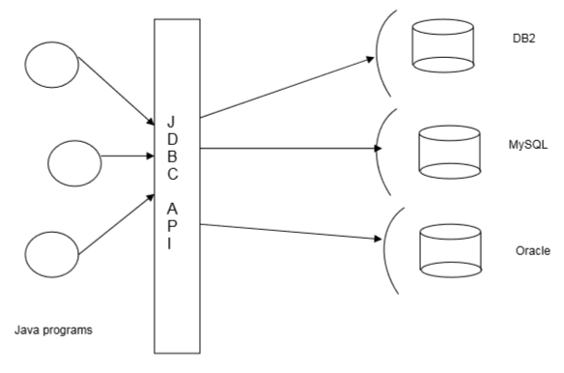

Slide 15
How JDBC talks with Databases
Databases are proprietary applications that are created by noted companies like Oracle, Microsoft and many more.
Every database will expose something called Driver through with one can interact with database for SQL operations.
A driver is like a gateway to the database.
Therefore, for any Java application to work with databases, it must use the driver of that database.

Slide 16
Database Drivers
A driver is not a hardware device. It’s a software program that could be written in any language.
Every database will have its own driver program.
Given a driver program of a particular database, the challenge is how to use it to talk with database. To understand this, we need to know the different types of drivers.
There are basically 4 different types of database drivers as described below:
  Type 1: JDBC-ODBC Bridge Driver
  Type 2: Partly Java and Partly Native Driver (Native-API Driver)
  Type 3: Intermediate Database access Driver Server (Network Protocol )
  Type 4: Pure Java Drivers (Thin Driver)

Slide 17
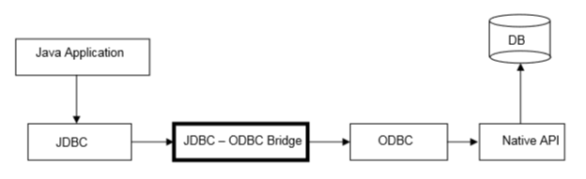
JDBC-ODBC Bridge Driver
This is also called as Type-1 driver.
Following shows the configuration of this driver.

Slide 18
As you can notice from the above figure, this driver translates the JDBC calls to ODBC calls in the ODBC layer.
The ODBC calls are then translated to the native database API calls.
Because of the multiple layers of indirection, the performance of the application using this driver suffers seriously.
This type of driver is normally used for training purposes and never used in commercial applications.
The only good thing with this driver is that you can access any database with it.
In simple words, with this driver for JDBC to talk with vendor specific native API, following translations will be made.
JDBC - > ODBC -> Native
It’s a 2 step process.

Slide 19
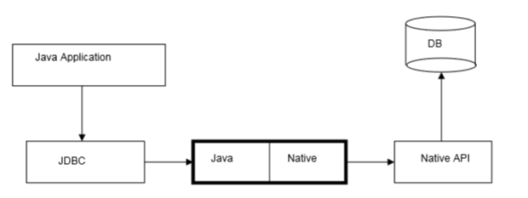
2. Partly Java and Partly Native Driver
This is also called as Type-2 driver. As the name suggests, this driver is partly built using Java and partly with vendor specific API. Figure below shows the configuration of this driver.

Slide 20
With this driver, the JDBC calls are translated to vendor specific native calls in just one step.
It completely eliminates the ODBC layer.
Because of this ODBC layer elimination, the applications using this driver perform better.

Slide 21
3. Type 3 Net pure java driver
If you look at the Type-2 driver configuration, we only access one database at a time.
However there will be situations where multiple Java programs need to access to multiple databases. This is where Type-3 driver is used.
It acts as a middleware for the applications to access several databases.
The Type-3 configuration internally may use Type-2 configuration to connect to database.

Slide 22
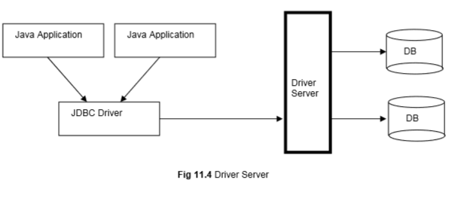

Slide 23
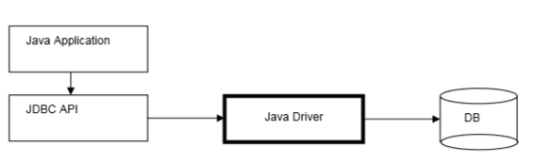
Type - 4: Pure Java Driver

Slide 24
JDBC API
JDBC technology is nothing but an API.It is a set of classes and interfaces that our Java programs use to execute the SQL queries against the database.
The fundamental idea behind JDBC is that, Java programs use JDBC API, and JDBC API will in turn use the driver to work with the database.
Therefore, to work with MySQL database, we need to configure the JDBC with all the MySQL information. This information is nothing but:
  Name of the MySQL driver class
  URL of the database schema.
In simple words, for a Java program to work with the database, we first need to configure JDBC with the above database info and then make the Java program use the JDBC.
Table lists the important JDBC classes and interfaces that we can use to build applications.

Slide 25
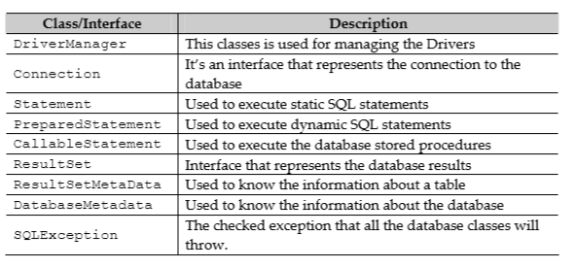

Slide 26
Steps for JDBC Program
Load the Driver
Get the connection to the database using the URL
Create the statements
Execute the statements
Process the results
Close the statements
Close the connection.

Slide 27
Register the driver class:
  First step is to load or register the JDBC driver for the database. Class class provides forName method to dynamically load the driver class.
  Syntax: Class.forName("driver ClassName");
Making a Connection:
  DriverManager class provides the facility to create a connection between a database and the appropriate driver.
  To open a database connection we can call getConnection method of DriverManager class.
  Syntax: Connection connection =DriverManager.getConnection (url,username, password) ;

Slide 28
Creating Statement:
  The statement object is used to execute the query against the database. statement object can be any one of the Statement, CallableStatement, and PreparedStatement types.
  To create a statement object we have to call createStatement method of Connection interface.
  Syntax: Statement stmt=connection.createStatement();
Executing Statement:
  The executeQuery method of Statement interface is used to execute queries to the database.
  This method returns the object of ResultSet that can be used to get all the records of a table.
  Syntax: ResultSet resultSet = stmt.executeQuery(selectQuery);
Closing Connection:
  After done with the database connection we have to close it. Use close method of Connection interface to close database connection.
  The statement and ResultSet objects will be closed automatically when we close the connection object.
  Syntax: connection.close());

Slide 29
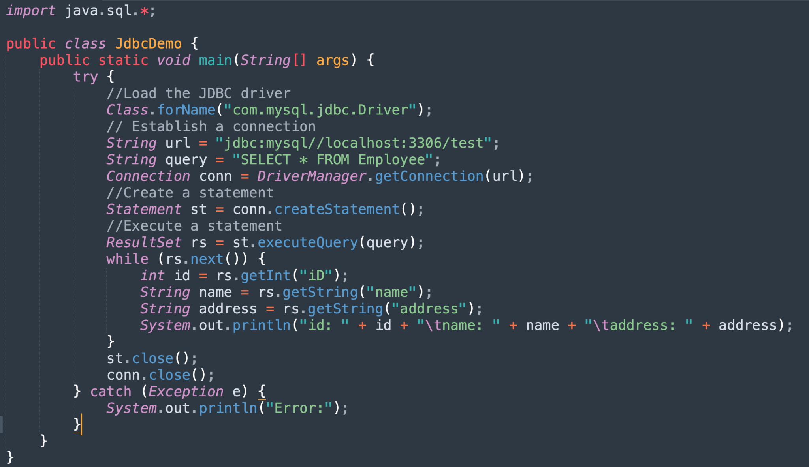

Slide 30
executeQuery vs. executeUpdate
- The executeQuery method is used to execute a SELECT statement and returns a ResultSet with the number of rows selected.
- The executeUpdate() si used to execute SQL statements such as INSERT, UPDATE or DELETE and it returns the number of rows affected.

Slide 31
SQL Exceptions
  In JDBC, we may get exceptions when we execute or create the query.
  SQL exceptions can occur either if the driver is missing or driver name is wrong or information about the database is wrong or the SQL query is wrong.
  Using Exception handling, we can handle the SQL Exception like we handle the normal exception.
  An SQLException can occur both in the driver and the database. When such an exception occurs, an object of type SQLException will be passed to the catch clause. SQLException is available in the java.sql package.
  The SQLException object has the following methods: getErrorCode(), getMessage(), getSQLState(), getNextException), printStackTrace().

Slide 32
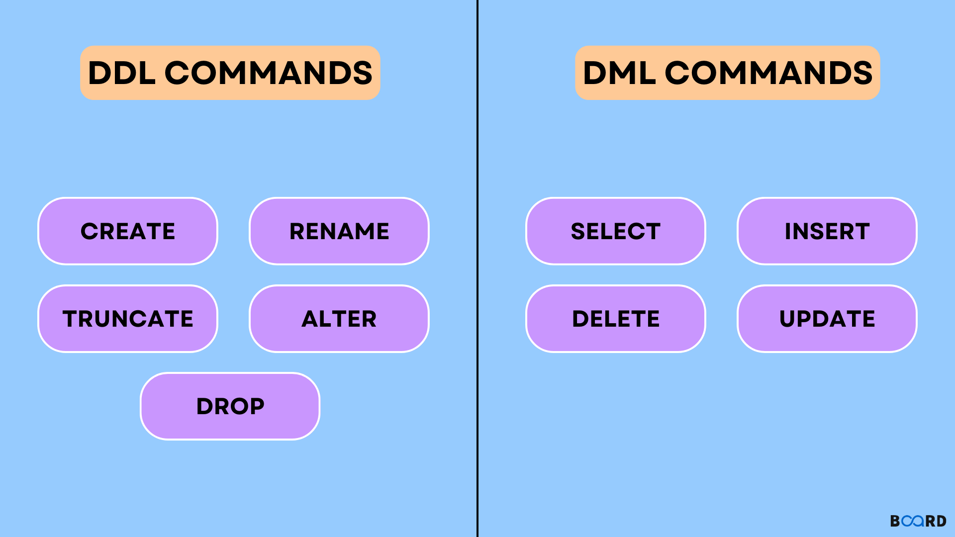
DDL vs DML

Slide 33
Prepared Statement
The PreparedStatement interface is a subinterface of Statement. It is used to execute parameterized query
The performance of the application will be faster if you use PreparedStatement interface because query is compiled only once.
The prepareStatement() method of Connection interface is used to return the object of PreparedStatement.
Example:
PreparedStatement stmt=con.prepareStatement("insert into Emp values(?,?)");
stmt.setInt(1,101);//1 specifies the first parameter in the query
stmt.setString(2,"test");

Slide 34
Multiple Results
When running a statement that returns more than one result set, we can use the execute() method of the Statement class.
It will return a boolean value that indicates if the value returned is a result set or an update count.
We can access the first result set by calling the getResultSet() method.
To determine if more result sets are available, we can call the getMoreResults() method, which returns a boolean value of true if more result sets are available.
If more result sets are available, we can call the getResultSet method again to access them, continuing the process until all result sets have been processed.
If the getMoreResults) method returns false, there are no more result sets ot process.

Slide 35
String SQL ="SELECT * FROM employees WHERE id <10; SELECT * FROM employees WHERE id >50;"
boolean results = smt.execute(SQL);
while (results) {
ResultSet rs = stmt.getResultSet();
while (rs.next) {
System.out.println(rs.getString("Id") +," " +rs.getString("Name") +," " +rs. getString("address"));
System. out. println();
}
results = stmt.getMoreResults();
}

